Slide 1




Raising Awareness and Understanding of
E-safety and CSE

Slide 2
A QUICK QUIZ?
WHAT IS CSE?
CHILD SEXUAL EXPLOITATION

Slide 3

Child sexual exploitation is a form of child sexual abuse.
It occurs where an individual or group takes advantage of an imbalance of power to coerce, manipulate or deceive a child or young person under the age of 18 into sexual activity (a) in exchange for something the victim needs or wants, and/or (b) for the financial advantage or increased status of the perpetrator or facilitator.
The victim may have been sexually exploited even if the sexual activity appears consensual.
Child sexual exploitation does not always involve physical contact; It can also occur through the use of technology.

Slide 4
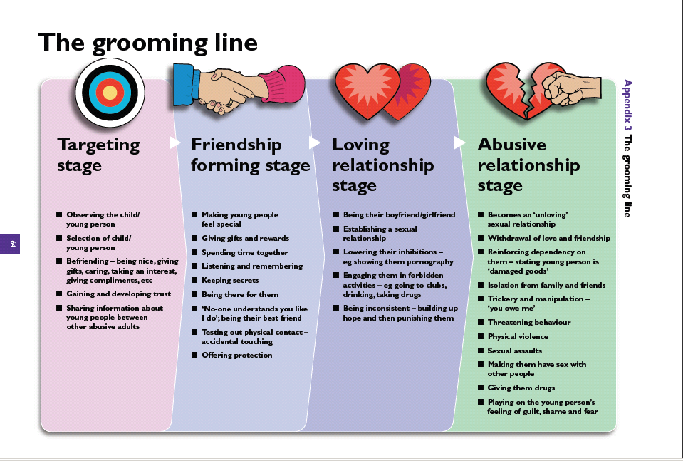

Slide 5

The warning signs that might mean a child is being abuse or exploited:
APPEARANCE AND BEHAVIOUR
SEXUAL
RELATIONSHIPS
MISSING / HOMELESSNESS
FINANCIAL

Slide 6
Appearance and behaviour:
Physical symptoms (Bruising suggestive of physical or sexual abuse)
Evidence of drug, alcohol or substance misuse
Volatile behaviour/mood swings/use of abusive language
Truancy/disengagement with education or change in performance in school
Low self-image, low self-esteem, self-harming behaviour
Physical aggression towards others
Change in appearance/always tired

Slide 7
SEXUAL:
Sexually transmitted infections/pregnancy/seeking an abortion
Sexually risky behaviour
Sexual/unexplained relationships with older people
History of abuse or neglect
Domestic violence/parental difficulties
Clothing – inappropriate for age, borrowing clothing.
Reports that the child has been seen in places know for CSE

Slide 8
RELATIONSHIPS:
Entering or leaving vehicles driven by unknown adults
Hostility in relationship with parents/carers and other family members
Reports to suggest the likelihood of involvement in CSE
Associating with other young people who are known to be exploited
Inappropriate use of internet and forming relationships with adults
Phone calls, text messages or letters from unknown adults
Adults or older youths loitering outside the child's usual place of residence

Slide 9
Missing / Homelessness:
Truancy
Placement breakdown
Persistently missing, staying out overnight or returning late
Returning after having been missing, looking well cared for in spite of having no known home base
Missing for long periods, with no known home base
Going missing and being found in areas where the child or young person has no known links

Slide 10
FINANCIAL:
Petty crime, shoplifting, stealing
Having keys to other premises
Expensive clothes, mobile phones or other possessions without explanation
Accounts of social activities requiring money
Possession of large amounts of money with no plausible explanation

Slide 11

Myths
There are very few ‘models’ of CSE
It only happens in certain ethnic/cultural communities
It only happens to children in care
It only happens to girls and young women
It is only perpetrated by men
It only happens to young teenagers by men
This only happens in large towns and cities
Some people can be both victims and perpetrators
Parents should know what is happening and be able to stop it
Children and young people can consent to their own exploitation

Slide 12
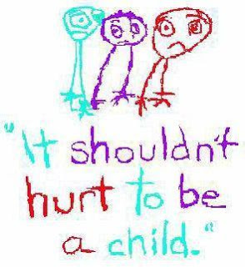
When Exploitation can happen?
Internet
Social Media
Parties
Socialising with older people
When you’re vulnerable
Not getting along with your family
When you’re not in education
Committing crime
Accepting gifts and invitations
Switching your phone off
Going missing
Not contacting family
Lying to family members about where you are and who your with...

Slide 13






Technology has developed and changed rapidly over the years

Slide 14


Our children are now more tech-savvy than ever
The average age a child uses the internet is 3

Slide 15

Children often know more than we do
56% of parents ask their children for advice on technology.
If we don’t know how can we protect them

Slide 16









The internet is an incredible resource, what are the best things about the internet for you?
Shopping
News
Games
Music
Chatting
Blogging
Finding out information
Banking
Videos/Films

Slide 17






But e-safety increasingly becomes an issue. What concerns you about the internet?
Hurtful comments
Viruses
Adverts
Strangers
Inappropriate Material
Spam/Junk messages

Slide 18



Children aged 0-5 are:
Using apps
Gaming
Downloading
Going Mobile

Slide 19




Children aged 6-9 are:
Using apps
Gaming
Downloading
Going Mobile
Chatting

Slide 20
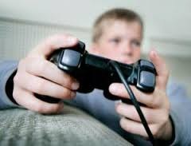



Children aged 10+ are:
Using apps
Gaming
Downloading
Going Mobile
Chatting
Social networking

Slide 21
Understanding the issues
Adults seeking inappropriate relationships with children.
Children could give out personal information without realising the risk. As they get older this risk increases as they start to share photos, videos and location via apps.
Children are unable to regulate time on devices.
Children can be exposed to inappropriate content by mistake or may start accessing unsuitable sites and games for their age. This risk increases as children get more internet savvy.

Slide 22
Children can accidently make in-app purchases.
Friendships can be developed with people children don’t know.
Children may say things they wouldn’t normally say face to face.
Access to Wi-Fi in public places is often unfiltered meaning children may come across inappropriate content.

Slide 23

How to deal with the issues
Protect you children by activating simple parental controls around your home. All major broadband providers offer these and allow you to block certain categories of websites and set time limits.
Categories that can be blocked by parental controls are:
Pornography and adult content.
Hate crime.
Drugs and criminal skills.
Suicide and self-harm.
Weapons and violence.
Dating.
Online gaming.
Social networks.

Slide 24
How to deal with the issues
Set and maintain boundaries to include how much time they spend online, only using devises in communal areas and they only view age appropriate content.
Use safe search on search engines and YouTube.
Talk to your child about what they do online and explore the internet together.
Find out who their friends are online and who they are chatting to and discuss that people online might not be who they say they are.
Talk about the possible consequences of sharing content.
Set passwords so they have to ask you when they want to go online.

Slide 25
Encourage them to treat people online as they would in real life.
Talk to them about what they might be sharing with younger siblings may not be appropriate.
Check age restrictions on games and apps that they are accessing.

Slide 26
PEGI
Pan-European Game Information age rating system
Established in 2003 to help parents make informed choices
Rates video games by age and also provides a content descriptor e.g. drug use or violence
Apple have a rating system for apps

Slide 27

Age Classifications for Games

Slide 28
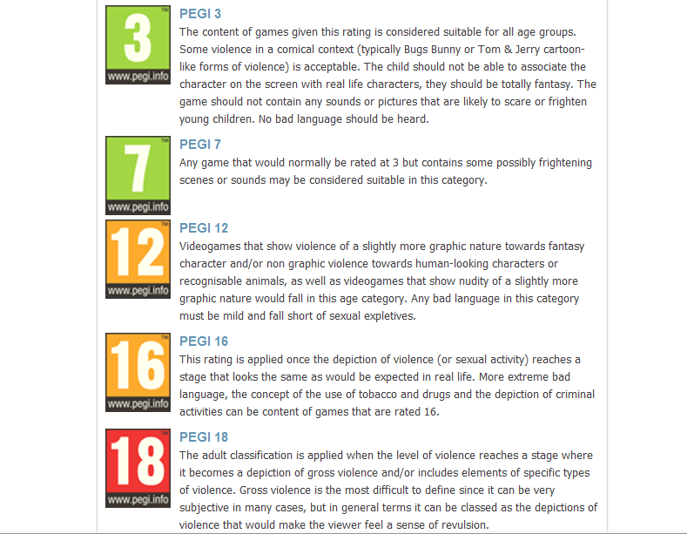

Slide 29
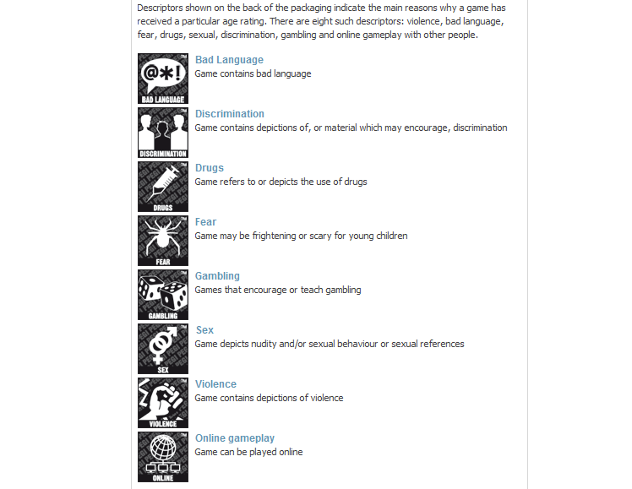

Slide 30
Guess My Age
See if you can guess the age rating of these video games.
What sort of content do you think they contain?
What are the concerns?

Slide 31

?

Slide 33


Slide 34
Concern
Ability to play with others online
  Remember people are not always who they say they are, remember to keep gaming friends ‘in-game’.
  Don’t give out personal information
  Don’t add people you’ve met in games to a social networking site if you have one

Slide 35




The apps official age rating varies greatly. On the IOS app store is it rated as suitable for 9 year + for “ infrequent/mild cartoon or fantasy violence”. On the google play store it is rated as Pegi 3 in the UK.

Slide 36
Concerns
Is meeting people they don’t know face to face.
There is a physical risk as it is easy to forget to look where you are going with this game.
It can cost a lot of money with in app purchases costing up £79.99 ( that’s 14.500 Pokémon coins)
Access to personal data.

Slide 37





Slide 38

4+

Slide 39



4+

Slide 40
Concerns
Online ability with open chat permitted with no official rules
Players could encounter offensive content, both in the messages typed by other players and in the freeform structures they build.
Potential also exists for players to share personal information, or bully each other.
Aggressive monsters

Slide 41



Slide 43



Slide 44
Concern
Exposure to age inappropriate content
  Sexual images
  Extreme violence
  Drug use
  Desensitising to extreme behaviours
  Inappropriate language and bullying behaviours
  Playing online potentially with people they don’t know

Slide 45
Parents need to know ..
It isn't a game for kids.
Playing as hardened criminals, players kill fellow gangsters, police officers and innocent civilians using both weapons and vehicles
Includes a particularly disturbing scene involving torture.
Women are frequently depicted as sexual objects, there are scenes where women can be raped and murdered.
Players also have the opportunity to make their avatars take drugs and drink alcohol.

Slide 46
Cyber Bullying
Definition
‘The use of digital technology (text messaging, email, social networking, online gaming) to bully, harass or abuse someone.’
DfE 2009

Slide 47
What the law says
Cyberbullying
Although bullying is not a specific criminal offence in UK law, criminal and civil laws can be applied.
Protection from Harassment Act 1997
Malicious Communications Act 1988
Section 43 of the Telecommunications Act 1984 Communications Act 2003
The age of criminal responsibility in the UK starts at 10 years old.

Slide 48
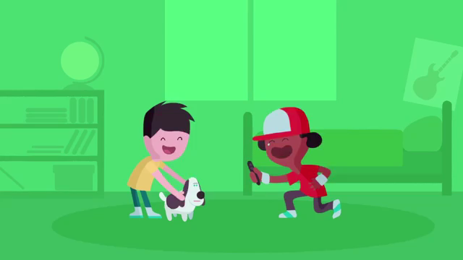
Sharing Images
  When sharing images children should consider:
  Who might see it?
  What could happen?
  The term sexting refers to the taking or sharing of inappropriate or explicit pictures or videos. This includes explicit text messages also.
NSPCC Share Aware campaign

Slide 49
What the law says
Although unlikely to be prosecuted, young people may be visited by the police and equipment removed.
Crimes involving indecent images of a person under 18 years fall under Section 1 of the Protection of Children Act 1978 and Section 160 Criminal Justice Act 1988. It is a crime to:
Take an indecent photograph or allow an indecent photograph to be taken
Make an indecent photograph (this includes downloading or opening an image that has been sent via email)
Distribute or show an image
Possess with the intention of distributing images
Advertise
Possess such images

Slide 50
PREVENTION- What can we do ?
Know the signs- and be alert
Acting on signs early can prevent abuse from happening or escalating.
Ensure lines of communication are open
Children and young people need to know they can talk to us about anything. Abusers often rely on the victim to be feeling shame or guilt to keep them silent.
Know their friends
Knowing your children's friends enables us to monitor who is likely to be a positive influence on them. Secrecy around friends could indicate unsuitability.
Take an interest in their online life
Talk about the sites they use, talk about the importance of not giving out personal information. Talk about the dangers of posting sexual images online and sexting.
Listen to children and young people
Look out for things they may be showing but not telling. Difficult behaviour could be an indicator that something is wrong.

Slide 51
How will we educate children at school about these issues?

Slide 52
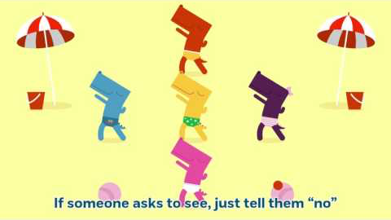
We’re going to start talking PANTS!

Slide 53

Lucy and the boy!

Slide 54
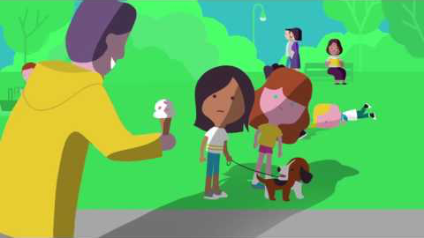
Mia

Slide 55

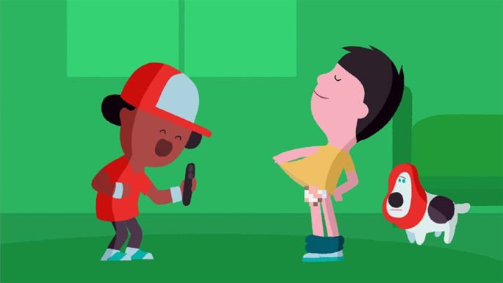
Report and Support
Report suspected online grooming – this could be sexual chat, a child being asked to do something that makes them feel uncomfortable or someone insisting on meeting up
www.ceop.police.uk
www.commonsensemedia.org
helpline@saferinternet.org.uk
NSPCC – Be share aware

Slide 56



Helpful websites

